Slide 1
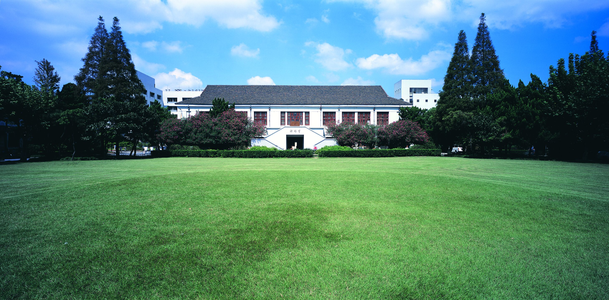
You Only Look Once
郑思晓 18210860040

Slide 2


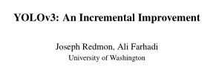
YOU ONLY LOOK ONCE
1
YOLOv1
CVPR 2016
2
YOLO 9000
CVPR 2017
3
YOLOv3

Slide 3
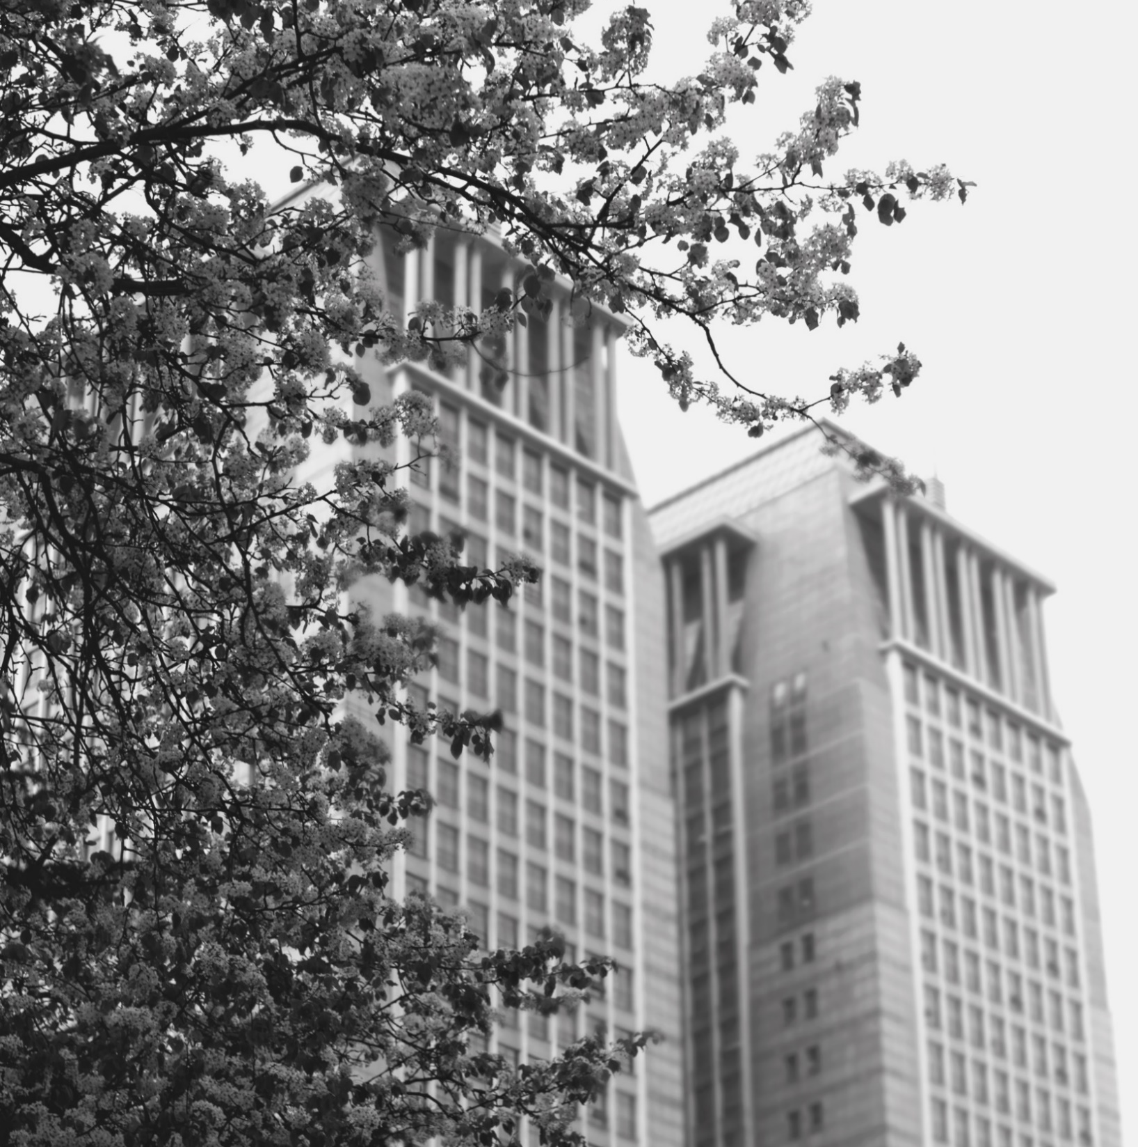
Introduction
1

Slide 4
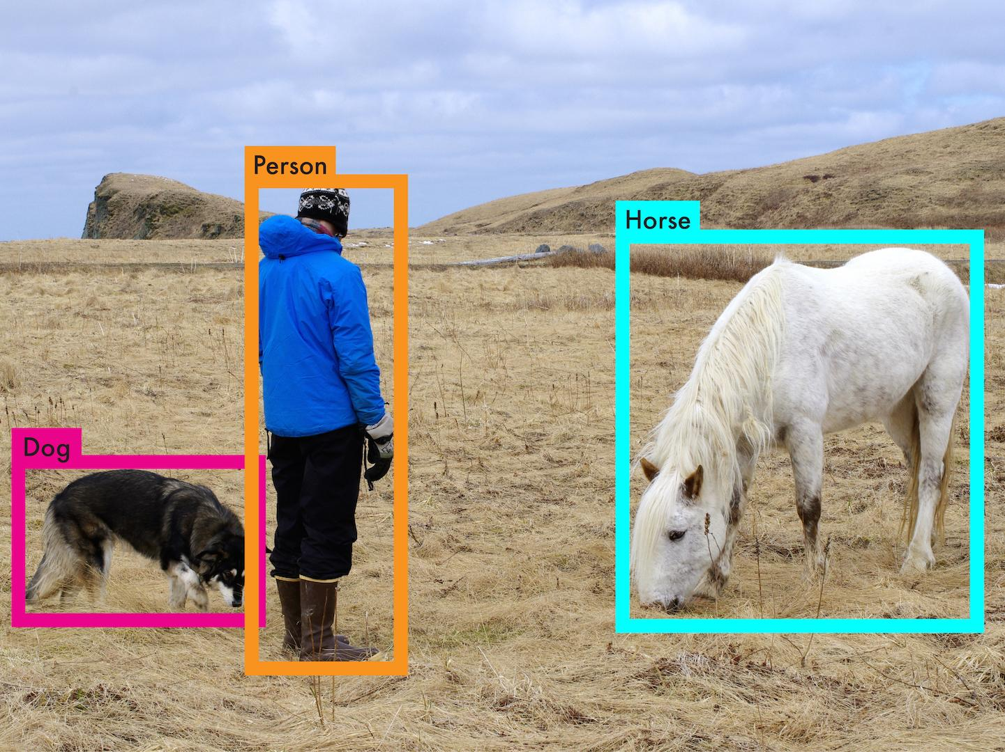

Slide 5
Object Detection
The human visual system is fast and accurate
Current detection systems：take a classifier for that object and evaluate it at various locations and scales in a test image.
deformable parts models (DPM):sliding window
R-CNN:region proposal,classifier, post-processing bounding boxes ,slow, train separately

Slide 6
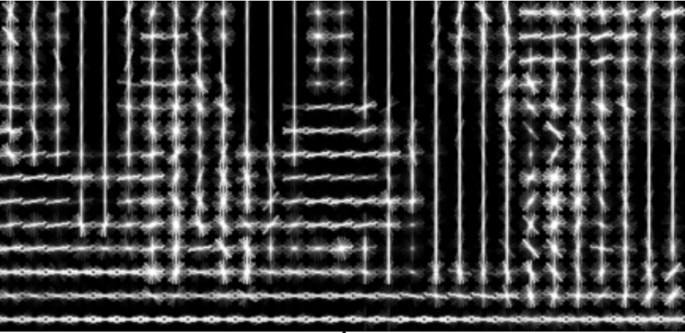
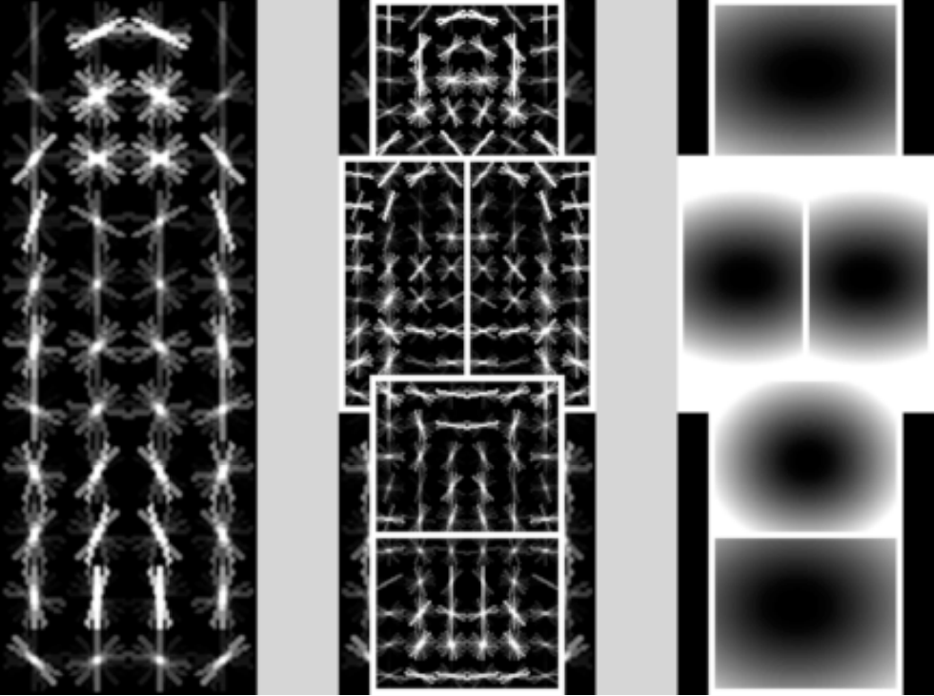
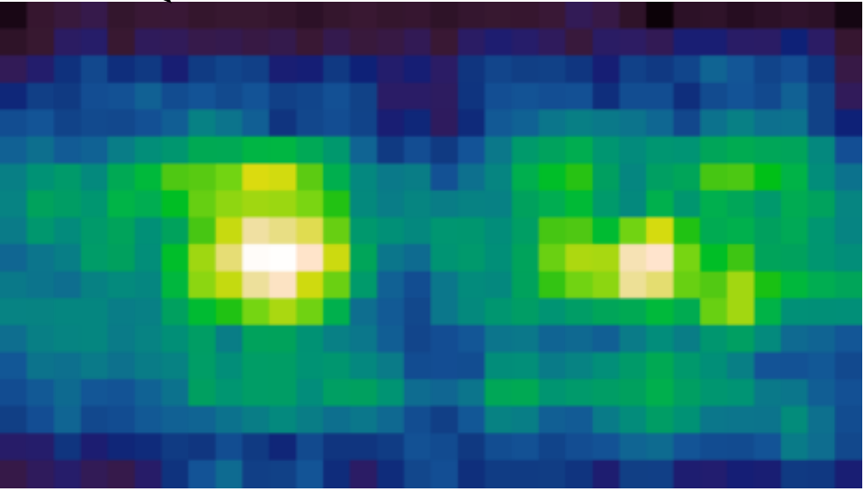
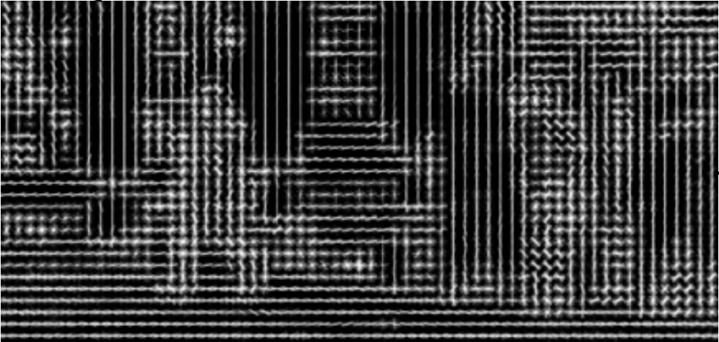
Deformable parts models(DPM)
sliding window approach
use a disjoint pipeline to extract static features
classify regions,
predict bounding boxes for high scoring regions

Slide 7
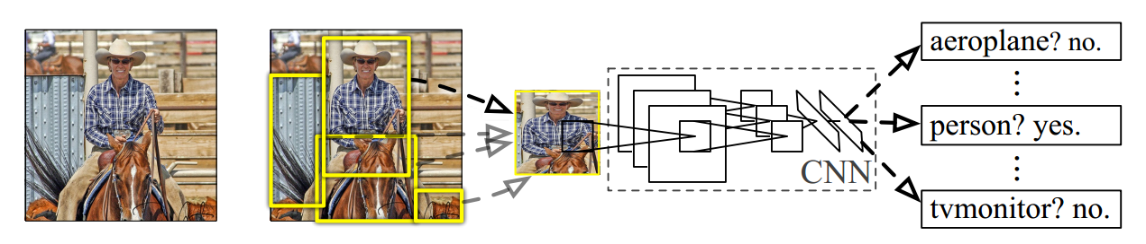
R-CNN
40 seconds per image
so slow！
1. Input image
2. Extract region proposals (~2k)
3. Compute CNN features
4. Classify regions (SVM)

Slide 8
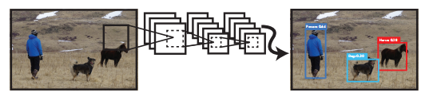
YOLO
YOLO reframe object detection as a single regression problem
straight from image pixels to bounding box coordinates and class probabilities.
YOLO: You Only Look Once

Slide 9
The benefits of YOLO
Fast:
45 fps on base network
150 fps on fast version
accuracy：
more than twice the mAP of other real-time systems
YOLO sees the entire image
encode contextual information about classes and appearance
generalizable representations of objects, like artwork
Notes:
contextual information 上下文信息

Slide 10
Module design
2

Slide 11
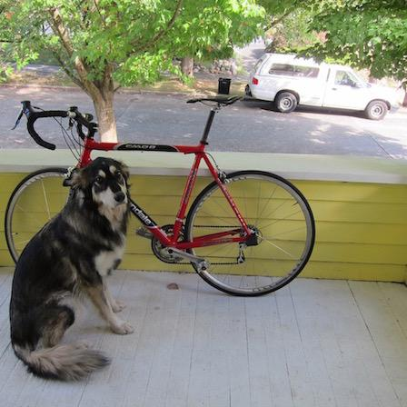
An image

Slide 12
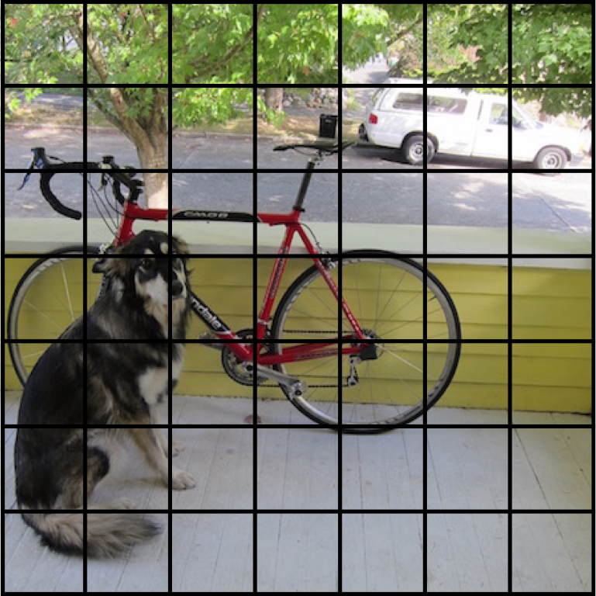
YOLO split the image into S x S grid
S=7

Slide 13
Each cell predicts B bounding boxes and confidence: Pr(Object)*IOU
B=2
Each bounding box:
(x,y,w,h,confidence)
(x,y):the center of the box relative to the bounds of the grid cell
(w,h):the width and height relative to the whole image
no object:
Pr(object)=0
confidence=0
object:
Pr(object)=1
confidence=IOU
Notes:
These confidence scores reflect how
confident the model is that the box contains an object and
also how accurate it thinks the box is that it predicts.
If no object exists in that cell, the confidence scores should be
zero. Otherwise we want the confidence score to equal the
intersection over union (IOU) between the predicted box
and the ground truth.

Slide 14
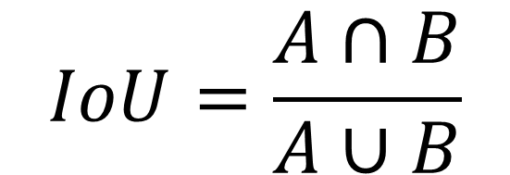
What is IoU?
A
B
A∩B
$$IoU=\frac{A∩B}{A∪B}$$

Slide 15
Each cell predicts B bounding boxes and confidence: Pr(Object)*IOU
B=2
no object:
Pr(object)=0
confidence=0
object:
Pr(object)=1
confidence=IOU
Each bounding box:
(x,y,w,h,confidence)
(x,y):the center of the box relative to the bounds of the grid cell
(w,h):the width and height relative to the whole image

Slide 16
Each cell predicts B bounding boxes and confidence: Pr(Object)*IOU
B=2
Each bounding box:
(x,y,w,h,confidence)
(x,y):the center of the box relative to the bounds of the grid cell
(w,h):the width and height relative to the whole image
no object:
Pr(object)=0
confidence=0
object:
Pr(object)=1
confidence=IOU

Slide 17
Each cell predicts B bounding boxes and confidence: Pr(Object)*IOU
B=2
Each bounding box:
(x,y,w,h,confidence)
(x,y):the center of the box relative to the bounds of the grid cell
(w,h):the width and height relative to the whole image
no object:
Pr(object)=0
confidence=0
object:
Pr(object)=1
confidence=IOU

Slide 18
Each cell predicts B bounding boxes and confidence: Pr(Object)*IOU
B=2
Each bounding box:
(x,y,w,h,confidence)
(x,y):the center of the box relative to the bounds of the grid cell
(w,h):the width and height relative to the whole image
no object:
Pr(object)=0
confidence=0
object:
Pr(object)=1
confidence=IOU

Slide 19
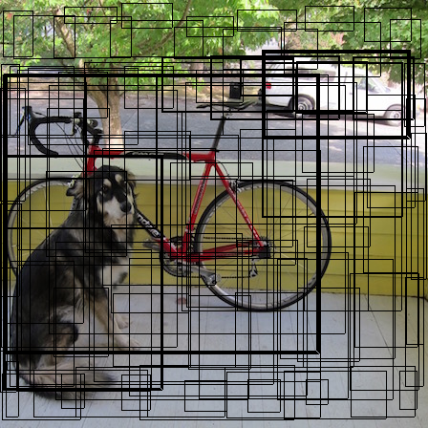
Each cell predicts B bounding boxes and confidence: Pr(Object)*IOU
B=2
Each bounding box:
(x,y,w,h,confidence)
(x,y):the center of the box relative to the bounds of the grid cell, [0,1]
(w,h):the width and height relative to the whole image,[0,1]
no object:
Pr(object)=0
confidence=0
object:
Pr(object)=1
confidence=IOU

Slide 20
Each cell also predicts C class probabilities
C=20
Notes:
These probabilities are conditioned on the grid cell containing an object.

Slide 21
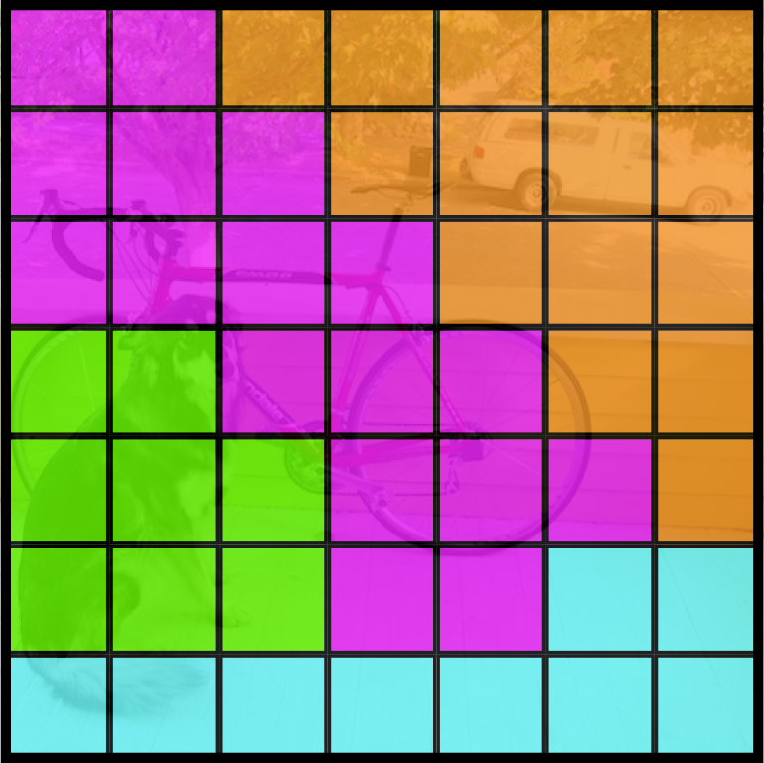
Each cell also predicts C class probabilities
Bicycle
Car
C=20
Dog
Dining Table

Slide 22
Conditioned on object: P(Car | Object)
Bicycle
Car
Dog
Dining Table

Slide 23
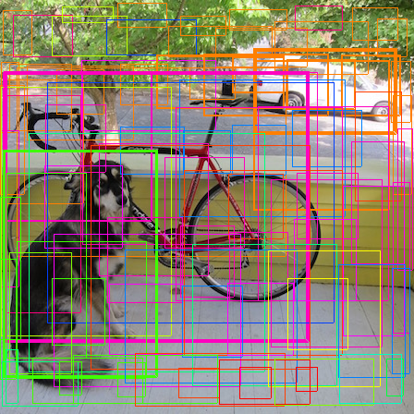
Then we combine the box and class predictions

Slide 24
Test time
class-specific confidence scores for each box.
These scores encode both the probability of that class appearing in the box and how well the predicted box fits the object.

Slide 25
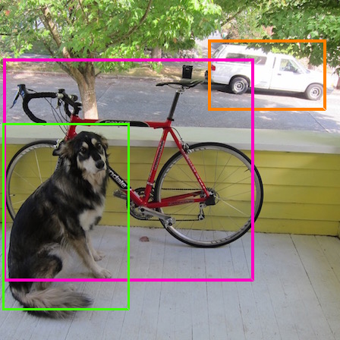
What is non-maximum suppression?
0.7
0.6
0.9
Discard all boxes with Pc<=0.6(Manually set)
While there are any remaining boxes:
Pick the box with the largest confidence
Output that as a prediction.
Discard any remaining box with IoU>=0.5(Manually set) with the box output in the previous step
0.8
0.8
0.9
0.6

Slide 26
Finally we do NMS and threshold detections
NMS adds 2- 3%
in mAP

Slide 27
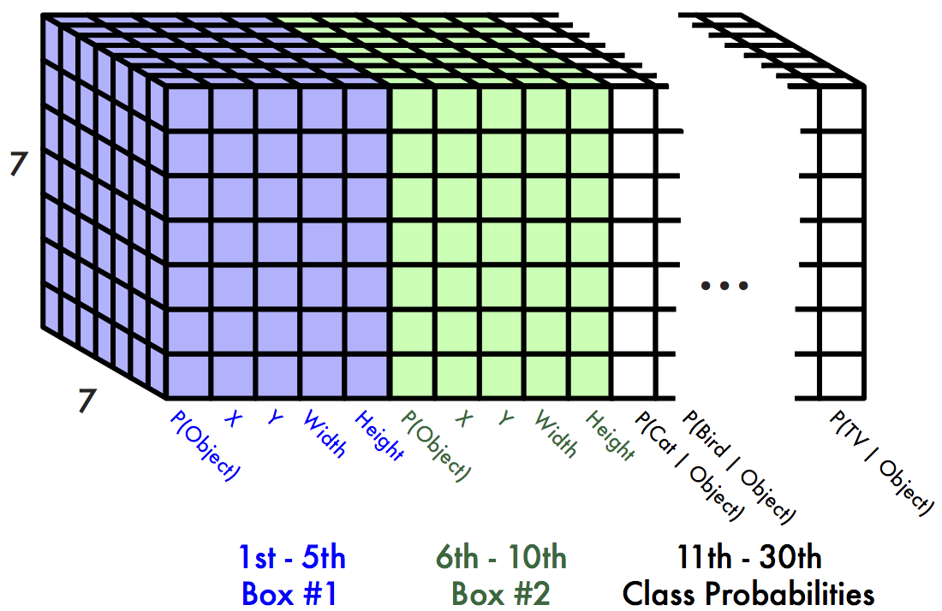
This parameterization fixes the output size
Each cell predicts:
For each bounding box:
4 coordinates (x, y, w, h)
1 confidence value
C class probabilities
For Pascal VOC:
S=7, 7x7 grid
B=2 bounding boxes / cell
C=20 classes
SxSx(Bx5+C)=7 x 7 x (2 x 5 + 20) = 7 x 7 x 30 tensor = 1470 outputs

Slide 28
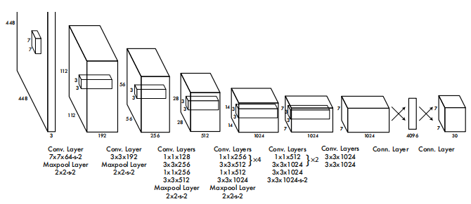
Network Design
inspired by the GoogLeNet model for image classification
24 convolutional layers :
extract features from the image
2 fully connected layers:
predict the output probabilities and coordinates.

Slide 29
Network Design
Fast YOLO
fewer convolutional layers (9 instead of 24)
fewer filters in those layers
Other than the size of the network, all training and testing parameters are the same between YOLO and Fast YOLO.

Slide 30
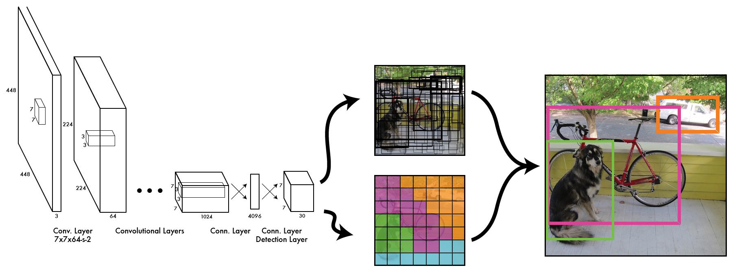
The Model
Thus we can train one neural network to be a whole detection pipeline

Slide 31
Training
3

Slide 32
During training, match example to the right cell

Slide 33
During training, match example to the right cell

Slide 34
Adjust that cell’s class prediction
Dog = 1
Cat = 0
Bike = 0
...

Slide 35
Look at that cell’s predicted boxes

Slide 36
Find the best one, adjust it, increase the confidence

Slide 37
Find the best one, adjust it, increase the confidence

Slide 38
Find the best one, adjust it, increase the confidence

Slide 39
Decrease the confidence of other boxes

Slide 40
Decrease the confidence of other boxes

Slide 41
Some cells don’t have any ground truth detections!

Slide 42
Some cells don’t have any ground truth detections!

Slide 43
Decrease the confidence of these boxes

Slide 44
Decrease the confidence of these boxes

Slide 45
Don’t adjust the class probabilities or coordinates

Slide 46
Detail of training
pretrain:
ImageNet 1000-class competition dataset
use the first 20 convolutional layers
followed by a average-pooling layer and a fully connected layer
input: 224 x 224
train for detection:
add four convolutional layers and two fully connected layers
randomly initialized
input: 448 x 448
dataset: PASCAL VOC 2007 and 2012
extensive data augmentation
Notes:
何凯明 Rethinking imagenet pre-training
imagenet 预训练非必须
135 epochs
dataset:PASCAL VOC 2007 and 2012
batch size:64
dropout rate=.5
extensive data augmentation
random scaling and translations
randomly adjust the exposure and saturation of the image

Slide 47
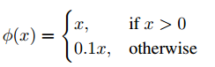
Activation Function
final layer: linear activation function
other layers: leaky rectified linear activation

Slide 48
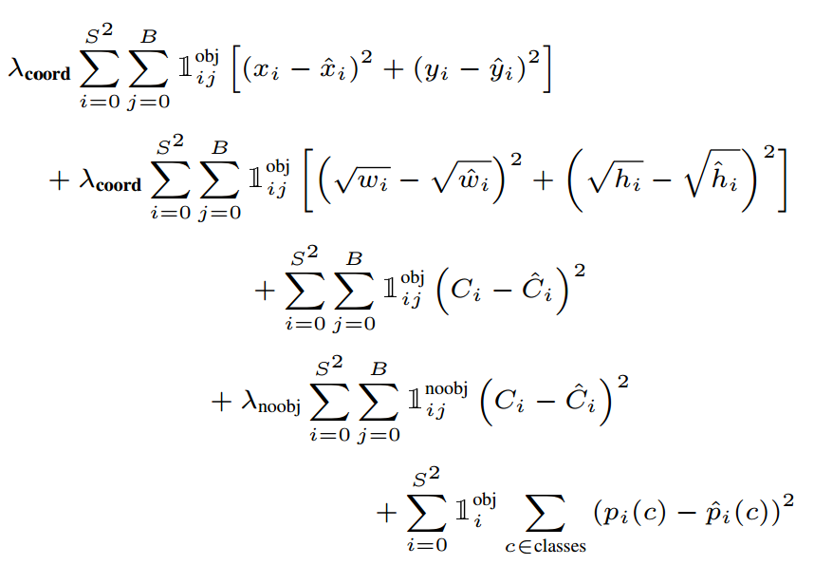
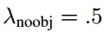
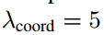
multi-part loss function
Notes:
localization error can not equally with classification error
许多grid cells 不包括object，so confidence is 0，ie. IOU=0 会导致模型不稳定，早期发散
减少没有object的权重，增加坐标权重
大 box的小偏差权重应小于小box的小偏差权重

Slide 49
Limitations of YOLO
strong spatial constraints on bounding box predictions
each grid cell only predicts two boxes and can only have one class
YOLO struggles with small objects that appear in groups
struggles to generalize to objects in new or unusual aspect ratios or configurations.
Accuracy rate is lower than state-of-the-art detection systems

Slide 50
Result
4

Slide 51
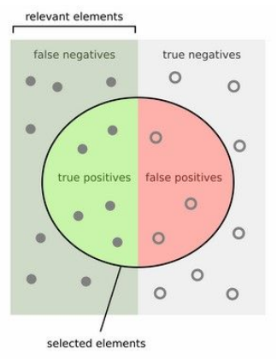
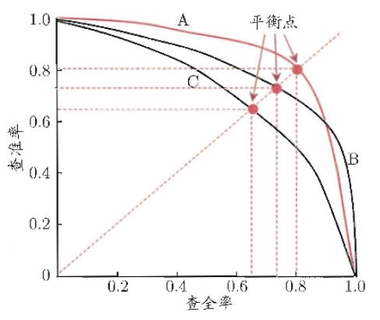
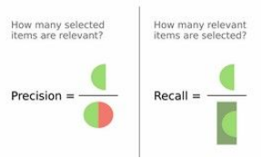
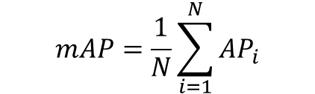
What is mAP?
Whoever evaluates your text cannot evaluate the way you write.
$$mAP=\frac{1}{N}\sum_{i=1}^{N}{{AP}_{i}}$$

Slide 52
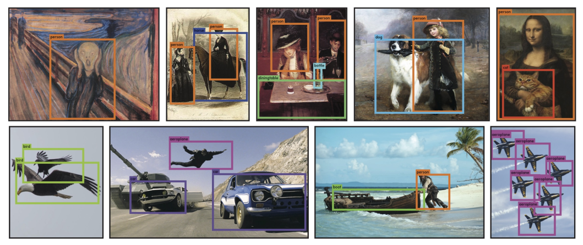
Qualitative Results
Notes:
YOLO works across a variety of natural images
It also generalizes well to new domains (like art)

Slide 53
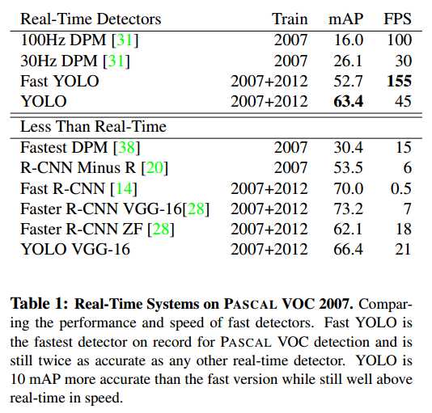
Comparison to Other Real-Time Systems

Slide 54
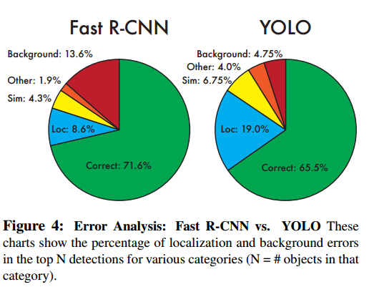
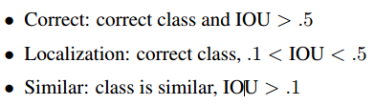
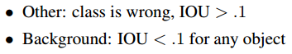
VOC 2007 Error Analysis

Slide 55
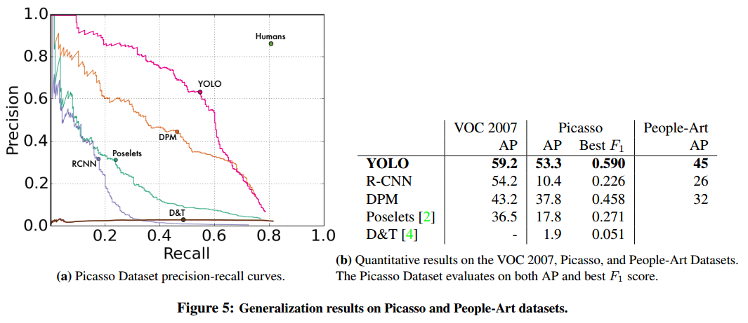
Generalization result
Notes:
YOLO outperforms methods like DPM and R-CNN when generalizing to person detection in artwork

Slide 56
THANKS

